Slide 1
CHC

Slide 2
Group Recommendation
CHC description as a recommender problem
A typical group recommendation problem
User1
User1
User2
User3
A user is recommended an item or a set of items
Group of 3 users is recommended an item or a set of items
Proposal
or
Proposal
Item
Item_1
, …,
Item_n
Item
or
Item_1
, …,
Item_n
A User is a TCN who is looking for a flat mate proposal.
An Item is a set of TCNs who can potentially be flat mates with the user

Slide 3
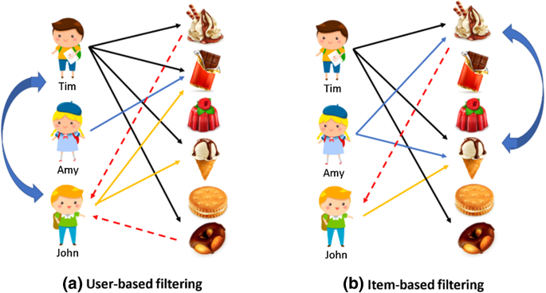
User-based and Item-based Collaborative Filtering
User-based:
Tim likes 1,2,4 and 6.
Arny likes 2.
John likes 2 and 4.
Most similar user to John is Tim. Since John might like what Tim likes, recommend 1 and 6 to John.
Item-based: 1 is liked by Tim and Arny.
2,3 and 5 aren’t liked by anyone.
4 is liked by Tim, Arny and John.
6 is liked by Tim.
So the most similar items are 1 and 4.
Therefore, offer 1 to John as well.

Slide 4
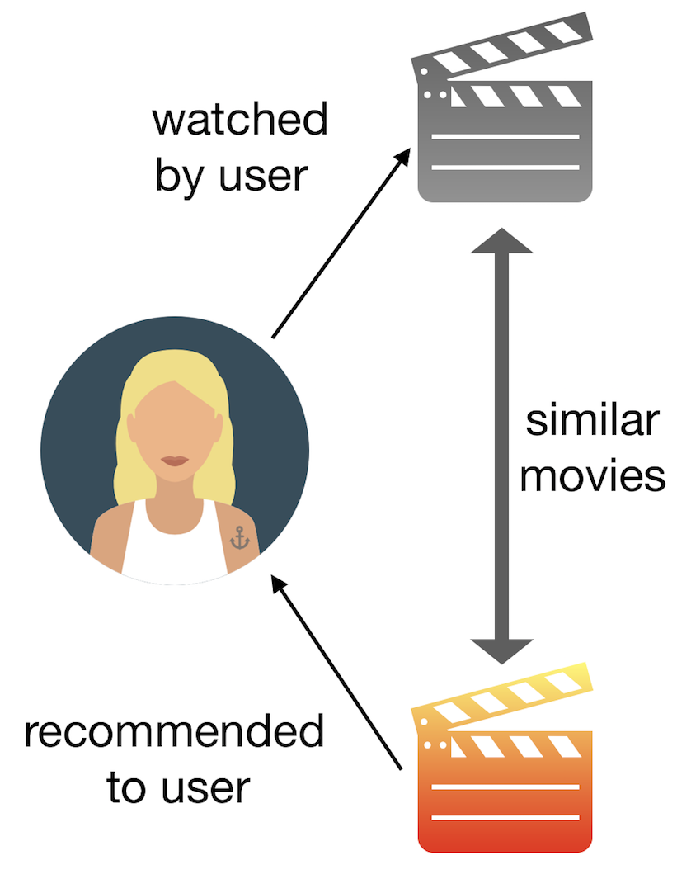
Content-based model
Content-based:
Items are movies
Each movie has attributes such as genre, duration, budget, actors and etc.
The similarity between movies is computed based on their attributes.
User watches movie_1
A rank list of similar movies to movie_1 is offered to the user.
Pros&cons are not correct. Modify them
Pros:
Items can be recommended without any feedback from any other user
Items can be recommended to a new user even with only 1 feedback unlike CF methods
Cons:
* User should give at least 1 feedback
General Workflow in Content-based:
User selects an item
Similarity in the algorithm is based on the comparison of the selected-item/user profile to other items in the DB
Similar items are recommended.
Envisioned general workflow in CHC:
User enters preferences
Similarity in the algorithm is based on the comparison of user to the other items
Similar items are recommended
HOWEVER, CHC could be solved as Content-based problem:
If user specifies preferences (genre, duration, year, etc.) which are used to build a model instead of selecting a movie.
The algorithm finds the similar movies based on the similarity between the model and other movies.
The similar movies are recommended.

Slide 5
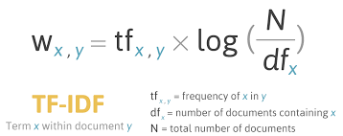
Content-based model
The input part of Content-based is ok.
Content-based produces a list of items which are most similar to the user profile.
Content-based algorithm:
The algorithm first builds user profile based on user preferences and builds a profile for each item.
Afterwards the algorithm computes the similarity values of user profile and every item profile by making use of cosine similarity technique.
And then it compares the values and produces a rank list of items from most similar to least.
The problem is, producing a rank list of TCNs is not enough for CHC based on user requirements.
TF-IDF: is a way to measure the importance of tokens/words in text. It turns a document into a list of numbers.
TF(t) = (Number of times term t appears in a document) / (Total number of terms in the document)
IDF(t) = log(Total number of documents/ Number of documents with term t in it)
Referance: https://medium.com/@bindhubalu/content-based-recommender-system-4db1b3de03e7
User profile (preferences) and item profile (demographics) can be build and compared to find the similar items. Similarity metrics can be cosine similarity or dot product. But to use them, the profiles should be in vector form. Mostly, TF-IDF is used to transform/create user/item profile vector in recommendation systems. Theoretically, if vectors can be created with TF-IDF, then pairwise similarity values can be generated with cosine similarity. Finally, those similarity values can be used as distance unit in ckmeans clustering to find clusters.
However, how reliable is it to compare the user and item profiles without comparing the attributes (age, gender…) separately?
Therefore, I think similarity matrix can be better than vector.
What is formal content-based algorithm? How the algorithm builds profiles and how the cosine similarity is computed? Is it possible to compute for TCN profiles? What is needed to compute cosine similarity?

Slide 6
Recommendation systems
Opinions on recommender systems:
So there are 2 types: collaborative filtering and content based.
Collaborative filtering has two types: a) user-based and b) item-based
Both of these 2 work similarly. They have their pros and cons. The idea behind CF is that the algorithms recommend new items based on the feedback from user. In other words, users must give feedback or rate the items such that the algorithms can compute and find what the user might like based on the items he/she liked so far. In our scenarios, we don’t have this kind of data such that the algorithms can use. Therefore, CF does fit to CHC and LCC.
2) Content-based recommendation: the idea is to find similar items based on the attributes of the liked item. So user selects an item, algo computes a user profile based on the attributes of the liked item and then finds the similar items based on the comparison between user profile and item profile. User profile can be built from explicit user preferences as well. But the algorithm produces a rank list of similar items which is not the requirement in CHC. In CHC, we need to recommend a list of GROUPS and content-based algorithm doesn’t compute groups. Therefore, content-based recommendation cannot be directly used for CHC but the similarity technique which is used in content-based can be used in CKMeans to calculate the similarity distance unit.
The question is, which similarity technique is better for CHC and why? Cosine similarity? Dot product? How the preferences and demographics will be described? As vector or matrix?

Slide 7
CHC as CKMeans
Cosine similarity
TCN:
12-5,7;13-7,6;14-1,3;15-6,4;16-8,2;17-9,4;18-7,7;19-3,9; …
*similarity in a scale of 10
In CKMeans-LCC, cluster center is compared with a TCN.
K=6; then cluster centers – {9,8,7,6,5,4}
In CKMeans-CHC, cluster center is compared with the similarity of the TCN with all other TCNs.
So →
C1=8,6~10={1,7}
C2=7,6~8,5={1,3,6,8}
C3=6,6~7,5={1}
C4=5,6~6,5={1,2,5}
C5=4,6~5,5={1}
C6=0~4,5={1,4,9}
Protocol:
TCN1 requests flat mate recommendation from agent1
Agent1 requests the list of active agents from WPM or WPM wakes all agents up (how to differentiate CHC/LCC agents if all of them are in the same cloud?)
Agent1 requests the demographic features from all active agents
(2nd option) Agent1 shares the complete demographics with other agents
Each agent computes a similarity value between itself and agent1
Each agent sends the similarity value to agent1
Once demographics are collected, agent1 computes pairwise similarity values with cosine similarity technique.
(2nd option) The distance unit in kmeans is the average of the similarities between 2 agents. For example, if S(agent1,agent2) is 7 and S(agent2,agent1) is 5, then the similarity value will be 6. And agent2 will be assigned to a cluster based on 6, not 7.
Then agent1 starts CKMeans and it uses these values as similarity distance. K is the number of clusters in the rank list which will be proposed to TCN1.
The clusters are then being proposed to TCN1 and each cluster contains TCN1 by default.
!!! The clusters which are proposed to TCN1, cannot be proposed to all other TCNs who are in the clustering. Because the cosine similarity values are calculated based on the preferences of TCN1. In other words, the similarity values are computed from agent1 perspective and they can be quite different for other agents. However, not sharing the result with all TCNs should not be a problem. This functionality is meant for 1 TCN but agents must coordinate since all of the demographic information is not collected at one place.
TCN
Demographics
Preferences
TCN
Demographics
Preferences
TCN
Demographics
Preferences
TCN
Demographics
Preferences

Slide 8
Similarity metrics
Similarity metrics:
Cosine similarity
Dot product
Euclidian distance
Pearson similarity

